Slide 1
Greek Theater

Slide 2
Introduction
Theater was presented at annual festivals held in honor of the gods.
One god, Dionysus, was honored with an unusual festival called the City Dionysia.
Dionysus was the god of wine, fertility, and revelry.
The revelry-filled festival was led by drunken men dressed up in rough goat skins (because goats were thought sexually potent) who would sing and play in choruses to welcome Dionysus.

Slide 3
Introduction
Tribes competed against one another in performances, and the best show would have the honor of winning the contest
Most historians believe that Greek drama originated out of the chorus, a group of 50 men who sang and danced a hymn to Dionysus.
Parallels with beginning of Medieval drama and theater.

Slide 4
Introduction
Thespis is credited with transforming these songs into drama when he stepped out of the chorus and became an actor.
He became a character and engaged in dialogue with the chorus.
Music was often played during the chorus' delivery of its lines.

Slide 5
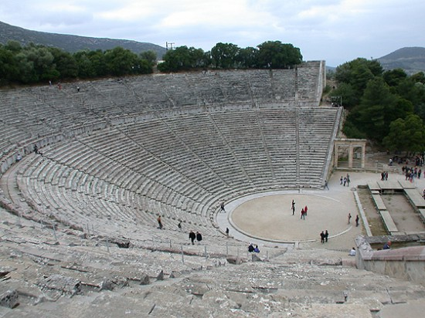
The Theater
Orchestra: circular dancing area for the chorus
Gently sloping hill, on which spectators could sit and watch the performance

Slide 6
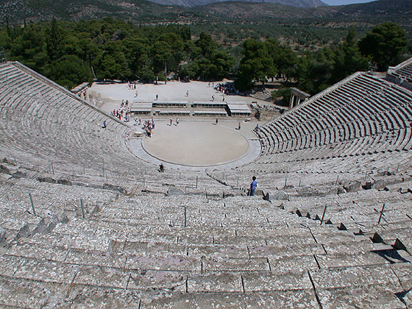
The Theater

Slide 7
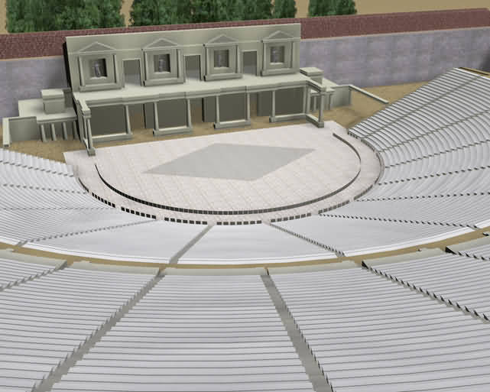
The Theater
Wall with doors, painted to represent a palace, temple or whatever setting was required.
Skene (‘tent’) probably a backstage area of some sort, into which the actors could retire during a show and change costume.
Eventually became a full-fledged stage building

Slide 8
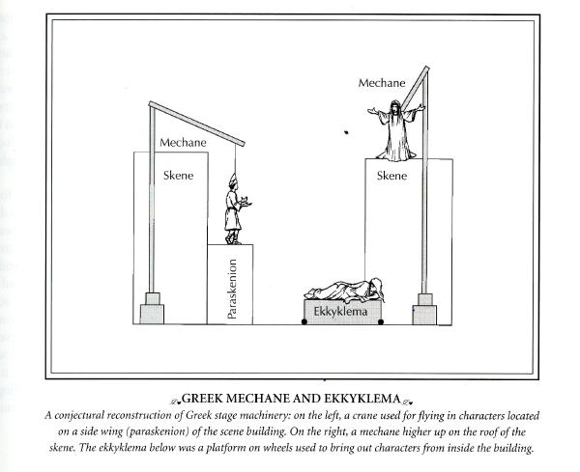

Slide 9
Stage
ekkyklema, a platform on wheels rolled out through one of the doors of the skene, on which a tableau was displayed representing the result of an action indoors (e.g., a murder) and therefore was unseen by the audience.
mechane `theatrical machine', a crane to which a cable with a harness for an actor was attached.
Could lift actors over the skene building and suspend them up in the air by a rope.

Slide 10
Stage
Allowed an actor portraying a god or goddess to arrive on scene in the most realistic way possible, from the sky.
Introduced a god at the end of a play in order to untangle a badly snarled plot.
The Latin phrase deus ex machina `the god from the machine' is often used to refer to the appearance of gods by means of the mechane in tragedy.
Employed in a pejorative sense in modern literary criticism to refer to an improbable character or event introduced by an author to resolve a difficult situation.

Slide 11
Actors
Thespian, which means “stage performer,” comes from Thespis.
The actors in tragedy were hired and paid by the state
Aeschylus added a second actor who could play different parts, wearing different masks. Chorus reduced to 12.
Sophocles added third actor, raised chorus to 15 (where it remained). Dramatic construction could then be much more flexible.
Actors were only men.

Slide 12
Chorus
Chorus important theater element.
The first function of a tragic chorus was to chant an entrance song called a parodos as they marched into the orchestra.
Sang and danced choral songs called stasima.
Usually represented ordinary citizens.
Reacted the way people in the audience might.
Gave background info necessary to understand the plot (exposition).

Slide 13
Chorus
Represented a moderate balance between the extreme behaviors of the principle characters
Made philosophical observations & drew conclusions about what was happening

