Slide 1
Invention of writing

Slide 2
Invention of writing
Earliest stories and songs were transmitted orally from generation to generation.
Risk of memorized literature being lost.
Need to keep important information preserved for the immediate and distant future.
Ended reliance upon oral tradition.

Slide 3
Invention of writing
The development of trade was one of several important factors in Mesopotamia that created a need for writing.
Earliest written documents: commercial, administrative, political, and legal information.
Pictographs were the beginning of pictorial art that evolved into writing.

Slide 4
Invention of writing
Earliest documents created by the first advanced civilizations in the Middle East, in the valleys of the Nile (Egypt), Tigris, and Euphrates rivers (Iraq).
Ancient civilizations were agrarian.
Cities became centers for government, religion, and culture.

Slide 5
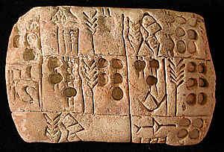
Invention of writing
The oldest writing was pictographic. The sign for an object was written to resemble the object itself.

Slide 6
Invention of writing

Slide 7
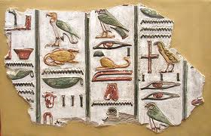
Invention of writing
In Egypt, scribes developed a writing called hieroglyphs, named at a later date after the Greek words for "sacred" and "carving“.

Slide 8
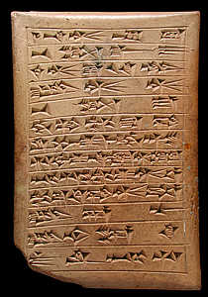
Invention of writing
3500 BC Sumerians invented cuneiform scripts, used for record keeping and recording historical information.

Slide 9
Invention of writing
Cuneiform means wedge shaped, due to the marks made by their writing tools as well as the shape of the tools themselves.
The original writing tool, a sharp pointed stylus was replaced with a triangular tipped one.
The new stylus was pushed instead of pulled through the clay.

Slide 10
Invention of writing
Pictographs evolved into an abstract sign.
Picture symbols began to represent the sounds of the objects depicted instead of the objects themselves.
It represents the first phonetic system of writing.

Slide 11
Invention of writing

Slide 12
Invention of writing
Abstract signs represent syllables, which are sounds made by combining more elementary sounds.
Cuneiform eventually became rebus writing:
pictographs representing words and syllables with the same or similar sound as the object depicted

Slide 13
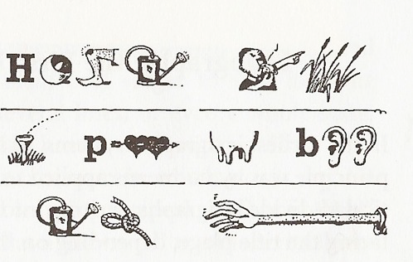
Invention of writing
Rebus writing:
Heineken refreshes
the parts other beers
cannot reach

Slide 14
Invention of writing
Libraries organized to contain thousands of tablets about religion, math, law, medicine and astronomy.
Literature sprang up in the form of poetry, myths, hymns, epics and legends on clay tablets.
Chronicles of the reigns of the kings were detailed.

Slide 15
Invention of writing
Cuneiform was used to record literature such as the Epic of Gilgamesh—the oldest epic still known.
Society stabilized itself with the standardization of weights and measurements and the rule of laws.
Establish ownership of property.
Certifying commercial documents.

