Slide 1
Jack London
“The Apostate”

Slide 2
Prayer.
“Now I lay me down to sleep,
I pray the Lord my soul to keep,
If I shall die before I wake,
I pray the Lord my soul to take. Amen.”
“Now I wake me up to work;
I pray the lord I may not shirk.
If I should die before the night,
I pray the Lord my work is right. Amen”

Slide 3
One day on Johnny’s life.
Johnny waking up. It’s 5:30 in the morning. One page description.
Holds on to bed covers.
Blows at the air.
“Lemme ‘lone!”
  “It was a bestial cry, as of a soul in torment, filled with infinite protest and pain”
Repeated every day.
Dragged his skinny legs. Sign of malnutrition.

Slide 4
Family members: mother, Johnny, brother Will, brothers and sisters, no father. What do you think happened to him?
Signs of poverty. Natural order
  Not enough food for everyone. Sharing bread. Coffee?
  Kerosene lamp
  Broken chair
  Had never seen a toothbrush
  Smelly sink
  Broken lid on the pot

Slide 5
Works far from the factory.
The role of the mother.
Factory whistle – time keeper for the town.
What he sees in the day:
  “the city lay in blackness”
  “ragged sky-line of housetops”
Inside the factory: machines, machines, machines.
What were his duties?

Slide 6
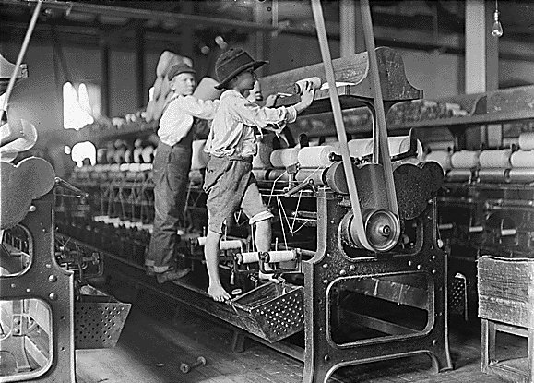

Slide 7
Emptying bobbins.
Worked mechanically.
Overseers.
Johnny – the perfect worker = perfect machine. How?
“It would have been as possible for a perfect nail-die to cut imperfect nails as for him to make a mistake.”
Arrival of the Inspector.
The one-legged boy.

Slide 8
End of the work day.
Supper time at home. Johnny irritated by the misbehavior of his brothers and sisters:
  “His own childhood was too far behind him. He was like an old and irritable man,”
Lost childhood.
“To Johnny had fallen the part of little father and little mother as well.”

Slide 9
The next day: “It was another day, of all the days, and all the days were alike.”
Back to his younger years.
At the age of six – father and mother to Will and the younger children.
Started working at the mills at seven.
At eight worked at another mill where he became a machine. Happy, easy job. Did not have to use his mind – machine like.

Slide 10
At nine worked at a glass factory – piece work, incentive to work harder.
“he had attained machine-like perfection. All waste movements were eliminated. Every motion of his thin arms, every movement of a muscle in the thin fingers, was swift and accurate.”
Gets sick, goes back to the mill, gets promotion.
Falls in love with the daughter of the superintendent.
She was much older than him.

Slide 11
His concept of love:
“On the surface of the cloth stream that poured past him, he pictured radiant futures wherein he performed prodigies of toil, invented miraculous machines, won to the mastership of the mills, and in the end took her in his arms and kissed her soberly on the brow.”
Imagines good future for himself, but that was long ago.

Slide 12
Manhood had come to him when he was eleven, when he worked on the night shift.
Great moments in his life: mom buys him prunes, she cooks custard for him. Finds a silver quarter (25 cents) coin. Never had his own spending money.
Buys candy, feels guilty, lost some change, feels it’s punishment by God.
Vague memories of his father, whom he had never seen.

Slide 13
“His earlier memories lingered with him, but he had no late memories. All days were alike. Yesterday or last year were the same as a thousand years -- or a minute. Nothing ever happened. There were no events to mark the march of time. Time did not march. It stood always still. It was only the whirling machines that moved, and they moved nowhere -- in spite of the fact that they moved faster.”

Slide 14
At sixteen promoted to work at another machine.
“Here was an incentive again, for it was piece-work. And he excelled, because the clay of him had been molded by the mills into the perfect machine.”
More responsibilities at home, children growing up, ore expenses.
There was no joyousness in life for him.
His consciousness was machine consciousness.
His mind was a blank.

Slide 15
He was a work-beast. He had no mental life whatever;
“yet deep down in the crypts of his mind, unknown to him, were being weighed and sifted every hour of his toil, every movement of his hands, every twitch of his muscles, and preparations were making for a future course of action that would amaze him and all his little world.”
Falls ill.
Gets better but refuses to go back to work.

Slide 16
Tells his mom he wants to go away.
Mom not surprised: "I might a-known it“
Reason for leaving: doesn’t want tp move any more. Counts the number of moves he had to make at the factory, millions.
“He did not walk like a man. He did not look like a man. He was a travesty of the human. It was a twisted and stunted and nameless piece of life that shambled like a sickly ape, arms loose-hanging, stoop-shouldered, narrow-chested, grotesque and terrible.”

Slide 17
Hops on a train. Doesn’t know where he is going.

