Slide 1
Chaucer
“Canterbury tales”

Slide 2
Introduction
Wrote in Middle English
First writer to write in English for the common man, not French or Latin, the languages at that time preferred by scholars
Chaucer was middle class, public servant.
  The Canterbury Tales: best contemporary picture of 14th century England
  Frame Story: story that provides a vehicle for telling other stories (stories within a story)

Slide 3
Introduction
“The Prologue”: introduction of diverse group of characters, including narrator
Tales characters share on pilgrimage to Canterbury
  Canterbury: site of shrine to St. Thomas à Becket
    His tomb became popular pilgrimage destination
Pilgrimage: journey taken to a place with religious significance

Slide 4
Introduction
Pilgrimage brings together 3 main segments of medieval society:
  Clergy
  Nobles
  Common people: Narrator (Chaucer),Wife of Bath
Basis for the frame story:
    The host proposes that each pilgrim will tell 2 stories on the way to Canterbury
    Winner of the contest will have free meal paid by all other pilgrims

Slide 5
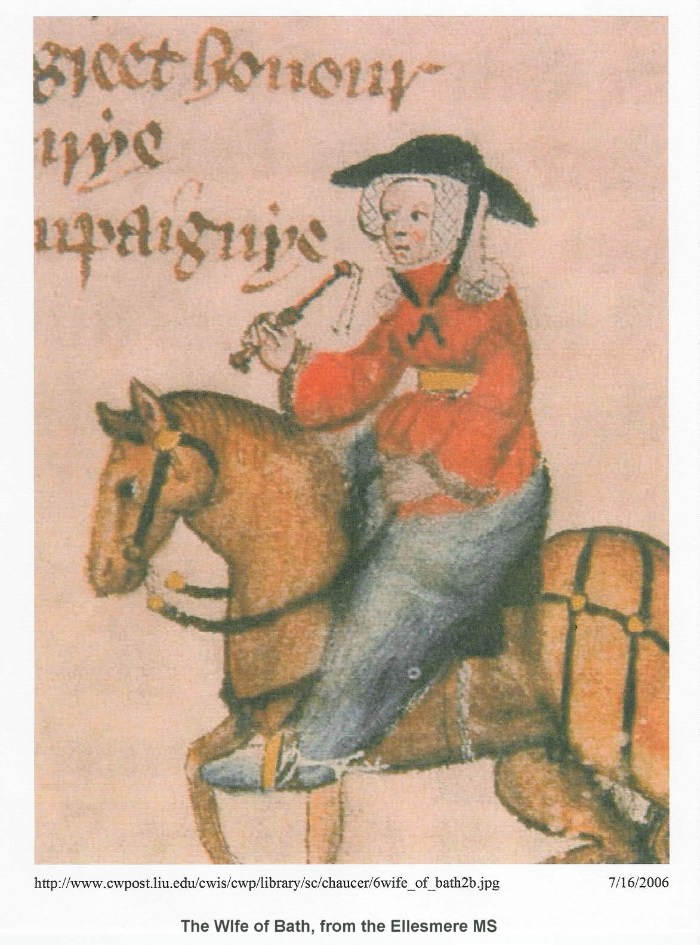
“The Wife of Bath”

Slide 6
“Wife of Bath Prologue”
Autobiographical in nature
Prologue in 3 main parts
  1. Arguments in favor of marriages
  2. Her marriages 1-4
  3. Life with number 5 Jankin
The Wife of Bath begins the Prologue to her tale by establishing herself as an authority on marriage, due to her extensive personal experience with the institution.

Slide 7
“Wife of Bath Prologue”
Has been married five times, and has grown rich herself
First married at 12 to a wealthy old man
Marrying young would help control women’s sexuality.
Jankyn
  Married for love.
  Half her age.
Jankin’s Books of Wicked Wives
Reads aloud from a book about bad wives every night

Slide 8
“Wife of Bath Prologue”
Controls her husbands through sex
She loved him, even though he treated her horribly and beat her.
This husband was also different from the other four because she married him for love, not money.
She doesn’t seem to like sex with her first husband only does it when she wants something
Enjoys sex, but does not like to be controlled by men

Slide 9
“Wife of Bath Prologue”
During her fourth husband’s funeral. She made a big show of crying, although, she admits, she actually cried very little since she already had a new husband lined up.
Her “prologue” is a debate with clerical “authority”
Wife expression of growing secularization which challenged authority to church
Undertakes to refute three sexist views of women:
  women should marry only once;
  virginity is the highest state; and
  the function of sexual organs
  Wife of Bath responds to Christian misogyny tradition of St. Jerome

Slide 10
“Wife of Bath Prologue”
St. Jerome (ca 320-420) wrote “On Marriage and Virginity,” associating women with evil and prescribing celibacy for priesthood
The Wife of Bath says that she has lots of experience about the “woe” that is in marriage, so she is entitled to talk about it
She is also well acquainted with authority, especially the Bible, which she knows remarkably well
People tell her that a woman should only be married once, because Jesus only went once to a wedding (the wedding at Cana, in the Gospel of St. John, 2:1)

Slide 11
“Wife of Bath Prologue”
She knows of no Biblical text that specifically determines the number of times a woman can marry, but she does know that the Bible tells us to “Be fruitful, and multiply”
Fundamental inconsistency between monastic ideals of virginity and the prime directive of Genesis 1 and 2: “Be fruitful and multiply.”
If everyone became a virgin, she observes, there would soon be no more virgins.
She knows of no Biblical text against bigamy

Slide 12
“Wife of Bath Prologue”
King Solomon had 700 wives and 300 concubines;
She wishes she could be “refreshed” only half as often as him
Sex organs were made for having sex
She wants a normal life like a man.

Slide 13
Wife of Bath’s Tale
In Arthur’s court young knight comes across a beautiful young maiden and he rapes her.
The court is scandalized by the crime and decrees that the knight should be put to death by decapitation.
Arthur’s queen and other ladies of the court intercede on his behalf and ask the king to give him one chance to save his own life.
Arthur, wisely obedient to wifely counsel, grants their request.

Slide 14
Wife of Bath’s Tale
The queen presents the knight with the following challenge: if, within one year, he can discover what women want most in the world and report his findings back to the court, he will keep his life.
If he cannot find the answer to the queen’s question, or if his answer is wrong, he will lose his head.

Slide 15
Wife of Bath’s Tale
The knight roams throughout the country, posing the question to every woman he meets.
Nearly every one of them answers differently.
Some claim that women love money best, some honor, some looks, some sex, some remarriage, some flattery, and some say that women most want to be free to do as they wish.
Some say that women most want to be considered discreet and secretive, although she argues that such an answer is clearly untrue, since no woman can keep a secret.

Slide 16
Wife of Bath’s Tale
As proof, she retells Ovid’s story of Midas.
Midas had two ass’s ears growing under his hair, which he concealed from everybody except his wife, whom he begged not to disclose his secret.
She swore she would not, but the secret burned so much inside her that she ran down to a marsh and whispered her husband’s secret to the water.
The Wife then says that if her listeners would like to hear how the tale ends, they should read Ovid.

Slide 17
Wife of Bath’s Tale
When his day of judgment draws near, the knight sorrowfully heads for home.
As he rides near a forest, he sees a large group of women dancing and decides to approach them to ask his question.
But as he approaches, the group vanishes, and all he can see is an ugly old woman.
The woman asks if she can be of help, and the knight explains his predicament and promises to reward her if she can help him.

Slide 18
Wife of Bath’s Tale
The woman tells the knight that he must pledge himself to her in return for her help, and the knight, having no options left, gladly consents.
She then guarantees that his life will be saved.
The knight and the old woman travel together to the court
The knight tells the queen the answer with which the old woman supplied him: what women most desire is to be in charge of their husbands and lovers.

Slide 19
Wife of Bath’s Tale
The women agree resoundingly that this is the answer, and the queen spares the knight’s life.
The old woman publicly asks the knight to marry her.
The knight cries out in horror.
He begs her to take his material possessions rather than his body, but she refuses to yield, and in the end he is forced to consent.
The two are married in a small, private wedding and go to bed together the same night.

Slide 20
Wife of Bath’s Tale
Throughout the entire ordeal, the knight remains miserable.
While in bed, the old woman asks the knight why he is so sad.
He replies that he could hardly bear the shame of having such an ugly, lowborn wife.
She offers the knight a choice: either he can have her be ugly but loyal and good, or he can have her young and fair but also unfaithful.

Slide 21
Wife of Bath’s Tale
He replies that he would rather trust her judgment, and he asks her to choose whatever she thinks best.
Because the knight’s answer gave the woman what she most desired, the authority to choose for herself, she becomes both beautiful and good.
The two have a long, happy marriage, and the woman becomes completely obedient to her husband.
The Wife of Bath concludes with a plea that Jesus Christ send all women husbands who are young, meek, and fresh in bed, and the grace to outlive their husbands.

