Slide 1
Colonialism in Africa

Slide 2
Colonialism: the occupation and control of one nation by another for economic advantage.
Although Europeans had had contact with many parts of Africa for a long time (through the Atlantic Slave Trade), they did not impose a formal rule of law over Africa until the period of colonization.
Colonial languages.

Slide 3
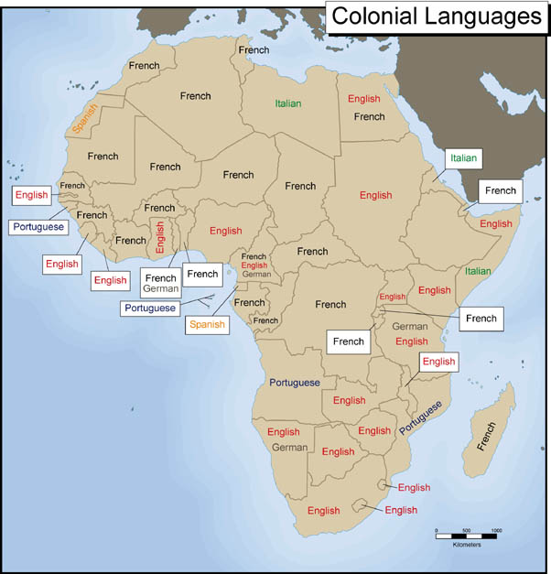

Slide 4
Colonial Conquest in Africa
The 19th century in Europe was a time of industrialization.
Factories in Europe required raw materials to be manufactured into marketable products.
Europeans sought both a source of raw materials, as well as, a market for manufactured goods in Africa.
This economic motivation played a large role in the colonization of Africa.

Slide 5
Colonial Conquest in Africa
One of the causes of the Scramble for Africa, (1885-1910) which resulted in the colonization of all of Africa in just twenty-five years, was the competition between European nations.
No major nation wanted to be without colonies.
Ideologies of racial hierarchy were prevalent in Europe in the 19th century.
Many Europeans viewed themselves as the most advanced civilization in the world, and some saw it as their mission to "enlighten" and "civilize" people in the rest of the world.

Slide 6
Colonial Conquest in Africa
This feeling of racial superiority and "responsibility" was captured in a poem written in 1899, The White Man's Burden by the British poet Rudyard Kipling (click on the title to read it).
Many inaccurate and racialized stereotypes of African peoples, which existed at the time, were used to justify colonialism in Africa.
The colonization of Africa coincided with the expansion of Christian missionary activity in Africa.

Slide 7
Colonial Conquest in Africa
Missionaries were supportive of the colonization of African countries.
European control would provide a political environment that would facilitate missionary activity in Africa.
This support for colonialism played an important role in legitimizing the colonial endeavor among the citizens of the colonizing powers in Europe.

Slide 8
Colonial Conquest in Africa
European nations made certain areas of Africa into their colonies in two main ways.
  Some African leaders were willing to sign treaties with Europeans .
  Force was used in some cases when there was a large amount of resistance to colonial rule.
The Treaty of Berlin (1884) and the "Scramble for Africa“.
Bismark of Germany initiated conference to regulate the rush for territory.

Slide 9
Colonial Conquest in Africa
By 1900, almost 90% of Africa was under European control.
Colonialism brings new borders for Africa.
The borders of African countries today were imposed from the outside by European nations.
Often the people who drew these borders paid no attention to ethnolinguistic groups or existing political organization at the time of colonization.
Sometimes they grouped together people who had never been united under the same government before.

Slide 10
Types of Colonial Rule
How to govern the newly acquired colonies?
1. Economic companies:
  Private companies that were granted large territories to administrate in Africa.
  Companies took responsibility for all of the expenses related to establishing and administering the colonies.
  European countries had the political benefit of having additional colonies in Africa, but not the expense!
  British East Africa Company, British South Africa Company.
  To expensive to govern, eventually replaced by colonial governments.

Slide 11
Types of Colonial Rule
2. Direct Rule
  The French, Belgians, Germans, and Portuguese are used this model in governing their African colonies.
  Centralized administrations, usually in urban centers, that stressed policies of assimilation.
  Colonialists had the intention of "civilizing" African societies so they would be more like Europe.
  Indigenous authorities had a subordinate place in these administrations.
  Direct rule used the strategy of "divide and rule" by implementing policies that intentionally weakened indigenous power networks and institutions.

Slide 12
Types of Colonial Rule
3. Indirect Rule
  British used indirect rule to govern their colonies.
  Used indigenous African rulers within the colonial administration, although they often maintained an inferior role.
  Indirect rule increased divisions between ethnic groups.

Slide 13
Types of Colonial Rule
4. Settler Rule
  European settlers imposed direct rule on their colonies.
  Settler colonies differed from other colonies in Africa in that a significant number of immigrants from Europe settled in these colonies.
  Settlers in Africa planned to make the colonies their permanent home.
  Settlers demanded special political and economic rights and protection.

Slide 14
Types of Colonial Rule
  Economic exploitation and political oppression of the African population that vastly outnumbered the settlers.
  Settler rule was characterized by its harsh policies toward the indigenous African population.
  Settler colonies were found primarily in southern Africa: South Africa, Southern and Northern Rhodesia (Zimbabwe and Zambia), Angola, Mozambique, and South West Africa (Namibia).
  Settlers from Holland, Britain, Germany, and Portugal colonized these areas.

Slide 15
Legacy of Colonialism
Colonialism is morally wrong.
Colonialism is un-democratic.
Colonial rule was most often imposed without consent from the African people.
Colonial governments not interested in providing basic infrastructure, roads, communication networks, social services, etc.
Consequences of “divide and rule”: policies that intentionally weakened indigenous power networks and institutions.

Slide 16
Legacy of Colonialism
Post-colonial ethnic conflicts in many parts of Africa have their roots in colonial policy of separating language, religious, and ethnic groups.
Development of resources for export, not for local use or consumption.
Policies of forced labor in order to provide adequate labor for mines and plantations.
Demand for labor resulted in large-scale movements of people.

Slide 17
Legacy of Colonialism
Dislocation of families. Families were often split up by migration. Men recruited to work in mines and on plantations often had to leave their families behind.
Urbanization. Urban living resulted in changes in economic activities and occupation, and in changes in the way people lived.
These changes often challenged existing values, beliefs, and social practices.

Slide 18
Legacy of Colonialism
Religious changers.
At the beginning of the colonial era, less than five per cent of the people in Africa identified themselves as Christian. Today, nearly fifty per cent of the people in Africa identify themselves as Christians.

