Slide 1
Akhenaten’s “Hymn to the Sun”

Slide 2
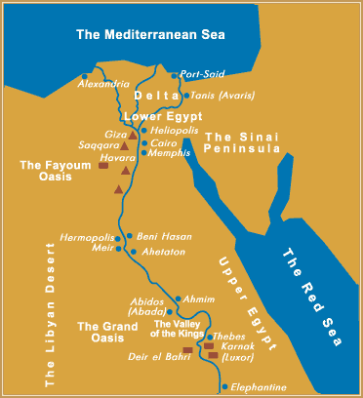

Slide 3
Egyptian religion extremely varied from one time period to another.
Cult of sun-worship spanning most of Egyptian history.
The sun, referred to as Ra or Re considered, “the principal god, creator of the universe, the source of all life.”
Sun-worship gradually spread until it encompassed most of Egypt.

Slide 4
The Egyptian Pharaoh was the embodiment of the sun on earth, or the son of Ra.
By the end of Amenhotep III’s reign (1386-1349 BCE), Amun-Ra had become the state deity of all Imperial Egypt.
Amun-Ra: conglomeration of deities from the north and south: Amun and Ra/Re.

Slide 5
The Aten was considered a deity which was represented by the disc or orb of the sun, “the living sun-disc”.
Related to the cult of Ra.
The Aten seen as the physical representation of Ra.

Slide 6
Thebes, the religious capital of Egypt at the time and home to the state god Amun-Ra.
Amenhotep IV (son of Amenhotep III) elevated as head of the pantheon a personified aspect of Ra, the Aten, which is the disk of the sun itself.

Slide 7
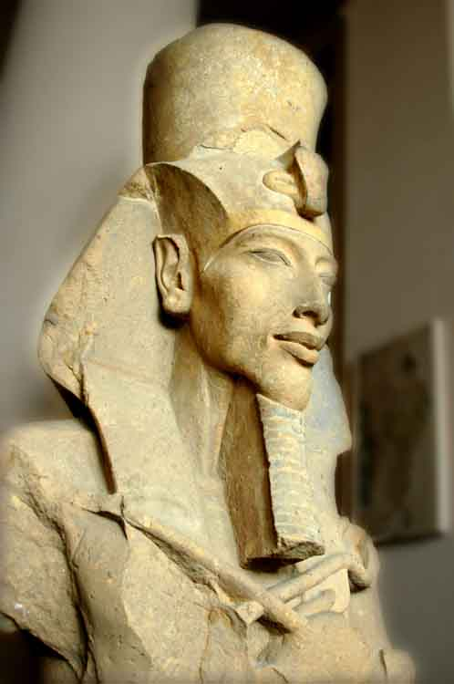
Amenhotep IV came to the throne of Egypt around 1353 BC. (1352-1338 BCE)
Also at this time that Amenhotep IV changed his official name to Akhenaten, “he who acts effectively on behalf of the Aten”.

Slide 8
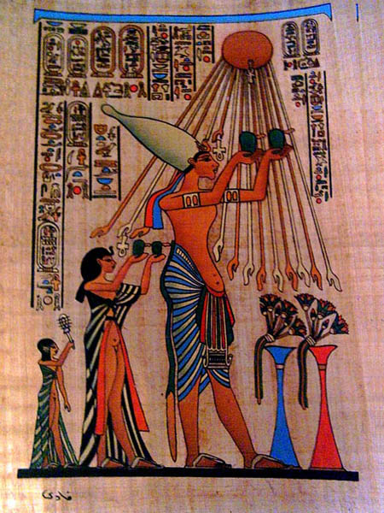
The Aten represented as a disk with rays of light.
Rays ending in hands which bless the king and his family.

Slide 9
Akhenaten set out to transform his people's deepest religious beliefs.
Moving from a polytheistic tradition to the elevation of a single solar god, Aten.
Radical revolt against fifteen hundred years of the most strongly ingrained, conservative religious and cultural traditions of Egypt.

Slide 10
Severed all links with the traditional religious capital of Egypt and its god Amun at Thebes.
Set to build an entirely new city that would be devoted solely to the cult of the Aten.
Chose a site in Middle Egypt for a new capital city which he called Akhetaten, 'Horizon of the Aten'.
Temples of the traditional deities would be closed and their priests dismissed from state service.

Slide 11
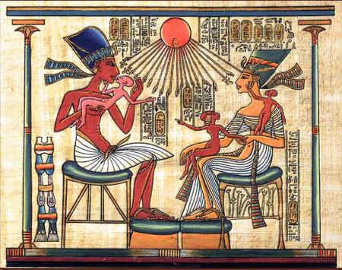
Many representations of the king and his queen Nefertiti seated under the beneficent rays of the Aten and holding their little daughters on their knees.

Slide 12
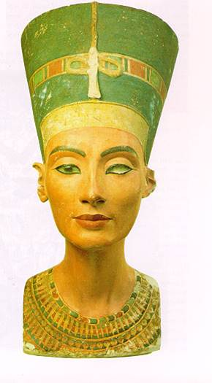
It was only through Akhenaten and Nefertiti that this god was accessed.

Slide 13
The close ties between the king and god are stressed through art and text.
The population was expected to worship the royal family, as the rays of the sun fell and gave life to only the royal pair.
In art increasing emphasis on ordinary, day-to-day activities which include intimate portrayals of Akhenaten and Nefertiti.

Slide 14
After about nineteen years, Akhenaten and Nefertiti disappear from history.
With his disappearance from the scene the priesthood attempted to obliterate his memory from Egypt and from history.
Many of his inscriptions were destroyed.
The process of restoration of traditional cults turned to whole-scale obliteration of all things associated with Akhenaten.

Slide 15
His image and names were removed from monuments.
His temples were dismantled and the stone reused in the foundations of other more orthodox royal building projects.
“Did Akhenaten’s religion influence or somehow affect the growth of monotheism among the ancient Hebrews?”
There is little evidence that Akhenaten’s religion spread much beyond Akhetaten, not even very far within Egypt.

Slide 16
"Hymn to the Sun"
Divided into 12 sections.
The wonders of the natural world are described to extol the universal power of the sun.
All creatures rejoice when the sun rises and nasty things come out at night when the sun is not present.
Origins of monotheism.
Sun as original cause/creator.
Establishing of parallelism between single human ruler and sun as universal ruler.

Slide 17
Pharaoh as son of sun god and interpreter of his will.
Fear of darkness and death, predators at night.
Dualism, light and dark,
Pastoral landscapes, vision of human order and work (crafts and professions);
All worship the sun
Fertility man-woman, understanding of reproductive functions;
Creation as sun god's handiwork (cf. human crafts; implied constructedness);

Slide 18
Vision of order, peace, growth, production.
Concept of destiny.
Mysteries of nature, awe before the variety and the ways of the natural world.
Mention of differences of languages, skin colors, nations.

Slide 19
Hapy the god of the Nile, earthly and heavenly Nile (rain);
Order, purpose in world;
One God, Aten, the Living Sun.
Privileged knowledge of Akhenaten;

